Slide 1
FLINT GLASS
Flint glass is type of optical glass used in lenses and other optical components.
Flint glass is an optical glass that has relatively high refractive index and low Abbe number. Flint glasses are arbitrarily defined as having an Abbe number of 50 to 55 or less. The currently known flint glasses have refractive indices ranging between 1.45-2.00.
A concave lens of flint glass is commonly combined with a convex lens of crown glass to produce an achromatic doublet lens because of their compensating optical properties.

Slide 2
CROWN GLASS
Crown glass is type of optical glass used in lenses and other optical components.
Crown glass is produced from alkali-lime silicates containing approximately 10% potassium oxide. It has low n (≈1.52) and low despersion (with Abbe Number around 60).
Generally, this is any glass with Abbe numbers in the range 50 to 85.
For example, the borosilicate gall Schott BK7 is an extremely common crown glass, used in precision lenses. Borosilicates contain about 10% boric oxide, have good optical and mechanical characteristics, and are resistant to chemical and environmental damage.

Slide 3
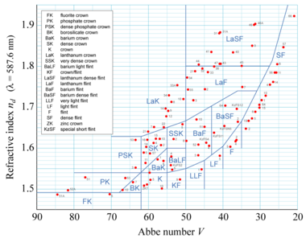

()convex
CROWN
FLINT
concave )(
where n_{D}, n_{F} and n_{C} are the refractive indices of the material at the wavelengths of the Fraunhofer D-, F- and C- spectral lines (589.2 nm, 486.1 nm and 656.3 nm respectively).
Low dispersion materials have high values of V.

